Slide 1
PRACTICAL COSTING
(20UCO4CC8)
DR. MOHAMED SHARIF. J
Assistant Professor of Commerce
Jamal Mohamed College (Autonomous)
Tiruchirappalli - 620021

Slide 2
MEANING
"Cost is the amount of resource given up in exchange for some goods and services. The resource given up are money and money's equivalent expressed in monetary units".
"Cost accounting is concerned with recording, classifying and summarizing cost for determination of cost of products or services, planning, controlling and reducing such costs and furnishing of information to management for decision making".

Slide 3
DEFINITION
"Cost accountancy" as the application of costing and cost accounting principles, method and techniques to the science, art and practice of cost control and the ascertainment of profitability.

Slide 4
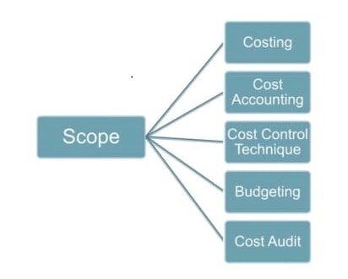
SCOPE OF COST ACCOUNTANCY

Slide 5
Costing:
The technique and process of ascertaining the cost.
Cost Accounting:
That branch of accounting dealing with the classification, recording, allocation, summarisation and reporting of current and prospective costs.
Cost Control Techniques:
The guidance and regulation by executive action of operating an undertaking."

Slide 6
Budgeting:
An overall blue print of a comprehensive plan of operations and actions expressed in financial terms.
Cost Audit:
The verification of the correctness of cost accounts and of the adherence to the cost accounting plan.

Slide 7
NATURE OF COST ACCOUNTING
Cost accounting is a branch of knowledge
Cost accounting is a science
Cost accounting is an art
Cost accounting is a profession

Slide 8
Distinguish between
Cost Accounting & Financial Accounting
Cost Accounts | Financial Accounts
Its purpose is internal reporting, i.e., to the management of every business. | Its purpose is external reporting mainly to owners, creditors, government, etc.
Provide adequate data for formulating pricing policy. | Fail to guide the formulation of pricing policy.
Furnishes cost data at frequent interval. | Provide financial information once a year.
Help in evaluating the efficiency of business. | Not sufficient to evaluate the efficiency of the business.

Slide 9
COST TECHNIQUES
Absorption costing
Marginal costing
Historical costing
Standard costing
Differential costing
Uniform costing

Slide 10
COSTING SYSTEM
Historical Cost System
Estimated Cost System
Standard Cost System

Slide 11
COSTING METHODS
Specific Order Costing | Operation Costing
Job Costing | Output Costing
Batch Costing | Process Costing
Contract Costing | Service Costing
Cost Plus Costing | Composite Costing

Slide 12
Need for cost classification
Ascertainment of profits periodically
In budgeting and planning process
Controlling cost
Pricing policy
Current application of plans and policies

Slide 13
CLASSIFICATION OF COST
On the basis of element of cost:
Material cost
Labour cost
Direct expenses
overheads
On the basis of function:
Production cost
Administration cost
Selling cost
Distribution cost
Finance cost
Research and Development cost

Slide 14
On the basis of controllability:
Variable cost
Fixed cost
Semi-variable cost
On the basis of normally:
Normal cost
Abnormal cost
On the basis of identify ability:
Direct cost
Indirect cost

Slide 15
On the basis of investment:
Capital cost
Revenue cost
On the basis of time:
Historical cost
Predetermine cost
On the basis of association with the product:
Product cost
Period cost

Slide 16
On the basis of decision-making:
Slink cost
Out of pocket cost
Opportunity cost
Imputed cost
Marginal cost
Replacement cost
Avoidable and unavoidable cost
Differential cost
Relevant and irrelevant cost
Conversion cost

Slide 17
COST SHEET
Cost sheet is an analytical statement of expenses relating to production of an article which informs regarding total cost, per unit cost and quantity of production.
According to Wheldon "Cost sheets are prepared for the use of management and consequently, they must include all the essential details which will assist the manager in checking the efficiency of production."

Slide 18
COMPONENTS OF TOTAL COST
Prime cost
Factory cost or Work cost
Office cost or Cost of production
Total cost or cost of sales

Slide 19
COST EQUATIONS
Prime Cost = Direct material cost + Direct labour cost
+ Direct expenses
Factory Cost = Prime cost + Factory overhead
Office Cost = Factory cost + Office & Administrative
overhead
Total Cost or Cost of Sales = Office cost + Selling overhead

Slide 20
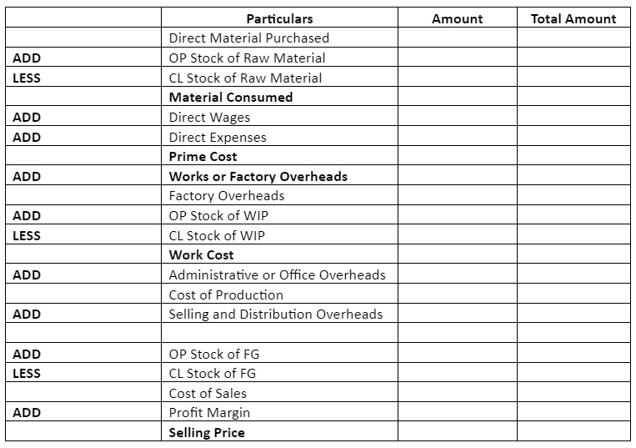
Cost sheet proforma

Slide 21
Tender
Tender is the response to an invitation of offer. This invitation provides services/products at quoted price at specific quality (with specific conditions). Generally tenders are floated by government undertakings, corporate players, and financial institutions.
They want goods at large scales in order to meet the production requirements. In most cases, in order to meet the requirement they can't deliver on their own and they have to go to a third party supplier to meet the requirements. For these reasons they invite bids from third party suppliers.

Slide 22
Quotation
Quotation is the formal document or document of promise given by supplier to supply goods & services to buyer at stated price under some specific conditions.
Quotation consists of terms of sales, payment, warranty, price to charge for product/services, time, date, delivery location, validity period. It also helps buyers in knowing the cost of goods/services before purchase. Generally government enterprises float the tenders.

Slide 23
major differences between tender and quotation
Tender | Quotation
Supplier bid on goods/services. | Document of estimated cost for supplying goods/services.
Find out the best price. | Offering fixed price.
Response for request for tender. | Response to request for quotation.
Price and quality are the components in Tender. | Price is the component in quotation.
Large scope. | Narrow scope.

